Slide 1
Content Potluck
Interlock between siloed teams.
Mine your own content.
Enterprise-wide content ideas.
Centralized editorial calendar for all content types.
No one can hide!
Content syndication.
Notes:
Laurel
So sorry Niki could not join us. We were star-crossed – she from marketing, me from tech comm. Together we built a cross-functional content potluck that leveraged content from many silos such as Professional Services, Product Marketing, Product Mgmt, Tech Comm, Support
What is a content potluck? When teams come together to mine their own content, develop holistic content of diverse types, and syndicate that content where our readers already visit.

Slide 2
How we built a content potluck
Found our champions with rich insights
Acquired cross-functional leadership support
Set a regular cadence of meetings
Got some tacos
Measured and reported results
Notes:
We can offer a laundry list of content creators, but finding your stakeholders is more than just finding the right departments to work with. Within these content development teams, you can usually find a representative that is passionate about content and collaboration. It might not be the manager; in fact, it frequently is not. Populating your interlock with ICs brings people who are closer to your audience to the table, and gives them opportunities for career growth.

Slide 3
Success Metrics
Uptime Bulletin (pdf) to HTML: 111 views to 8,901 views
Marketing video: 50 views vs. SME blog post: 10,005 views
Social Media Sharing: 250% growth in engagement (raising 5.3x per post)
AMA thread on average 4,053 views vs. regular pages ~2256 views (~80% growth)

Slide 4
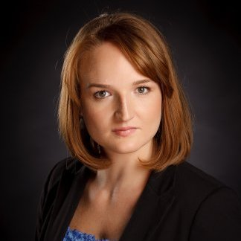
Thank you for your attention! Learn more at www.contentpotluck.com
Nikoletta Vecsei Harrold
Director Communities Strategy, Transamerica
@Nikschen
https://www.linkedin.com/in/nikolettavecsei
Laurel Nicholes
Director, Product Content Experience,
F5 Networks
@LaurelNicholes
https://www.linkedin.com/in/laurelnicholes

